Slide 1

School of Computer Science Engineering
Subject Name: Discrete Mathematics Subject Code: BBS01T1006
CAT-3 Presentation
Travelling Salesman Problem
Programme Name: CSE
Section: 24
Session: 2021-2022
Submitted By:
1. Aviral Gaurav 21SCSE1300029
2. Deepansh Bhatia 21SCSE1011677
3. Neeraj Singh 21SCSE1011675
4. Abhinav Kumar Choudhary 21SCSE1011615
Submitted By:
Harshita Shekhar

Slide 2
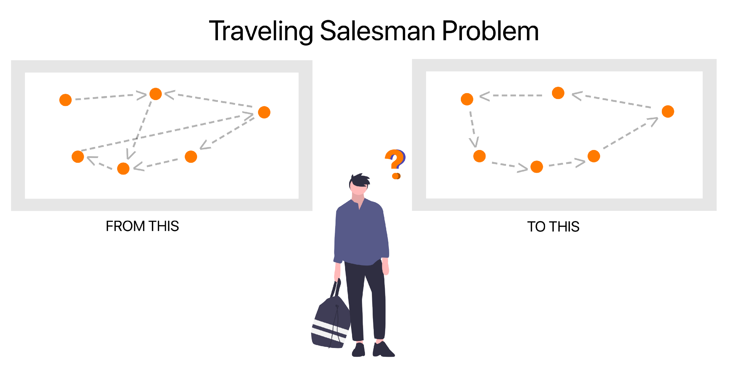
PROBLEM STATEMENT
PROBLEM : A travelling salesman wishes to visit a number of towns and then return to his starting point. Given the travelling times between towns, how should he plan his itinerary so that he visits each town exactly once and travels in all for as short a time as possible?

Slide 3
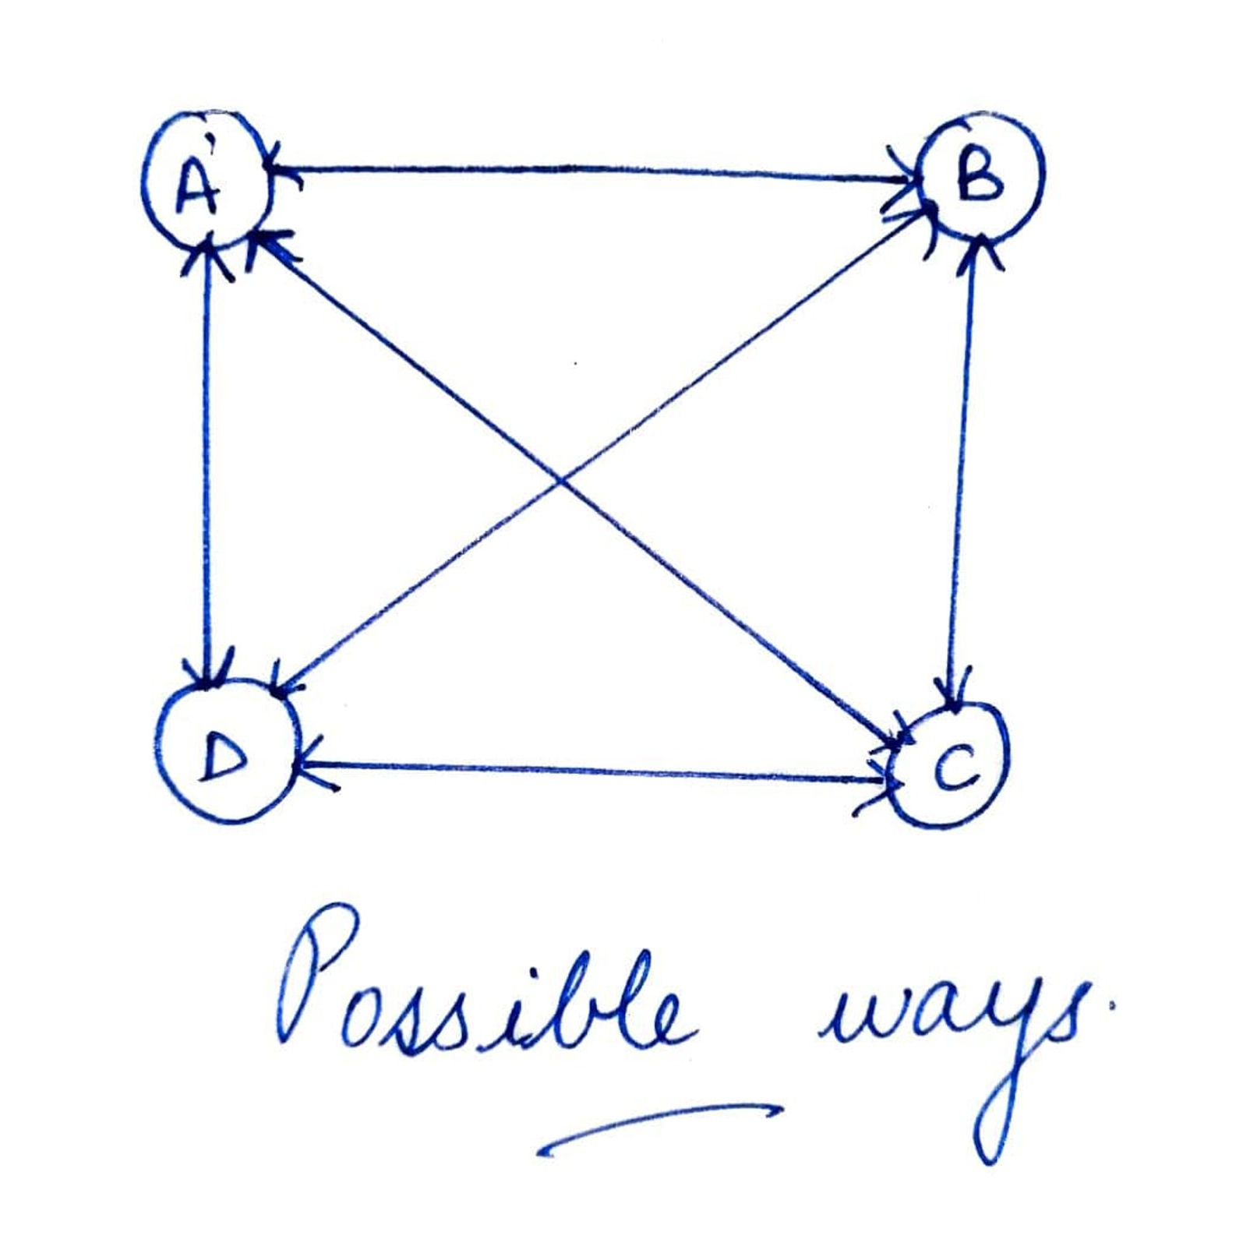
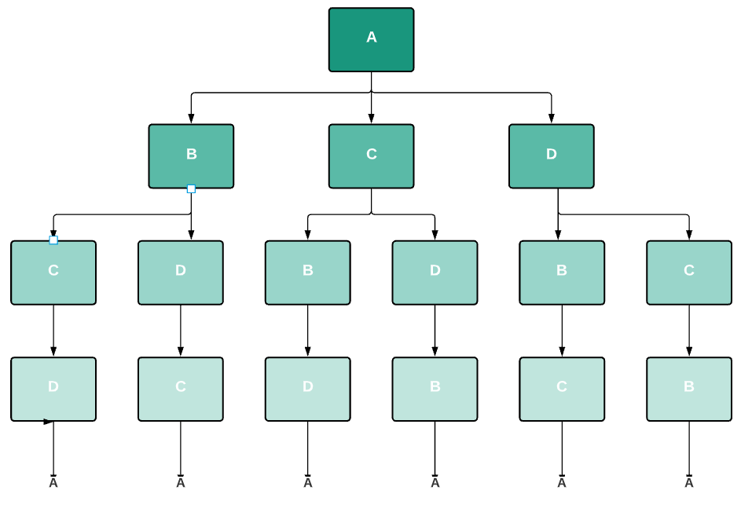
LIST OF INSTRUCTION
Here, the nodes represent cities, and the values in each edge denote the distance between one city to another. Let’s assume a salesman starts the journey from the city A. According to TSP, the salesman needs to travel all the cities exactly once and get back to the city A by choosing the shortest path. Here the shortest path means the sum of the distance between each city travelled by the salesman, and it should be less than any other path.

Slide 4
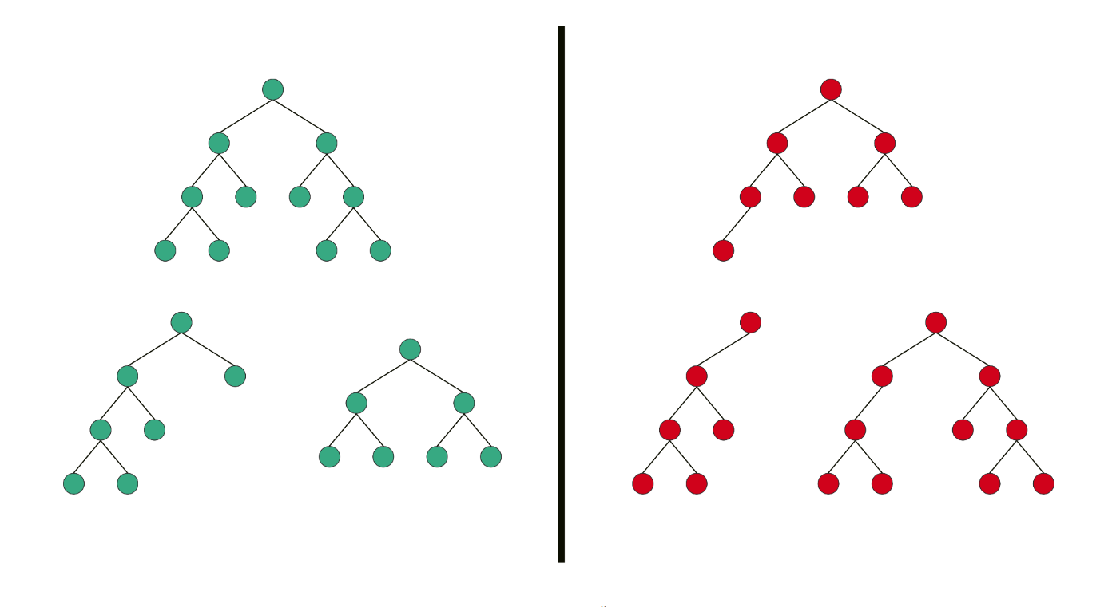
POSSIBLE SOLUTION
1) As We all have studied the Recursive technique, in programming, where the function calls itself, till it reaches to an end. Here, In dynamming programming similar procedure had been followed which made us to opt this method.
2) Here, what we have to do,
We are provided with the set of 4 cities and we have to calculate the possible shortest Route or Distance.
The Condition to be noted is the salesman visits every city exactly once and then return to starting point .
So, we are using the concept of Dynamic calculation (Tree method), in order to calculate the shortest distance.
3) It is basically a branch type structure where we will be calculating via different nodes. Dynamic calculation/programming basically an optimization over plane recursion. Here, we will notice repeated calls for same input.

Slide 5
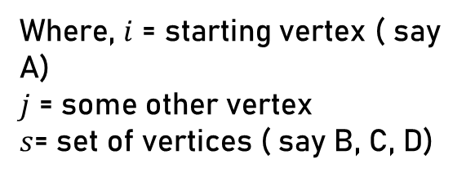
FORMULA
Here, we are going to discuss “Route Traversing Method” first and then finally we solving that problem by the formula :
$$g\left(i,s\right)=min⁡[w\left(i,j\right)+g\left(j,\left\{s−j\right\}\right)]$$
Where, $i$ = starting vertex ( say A)
$j$ = some other vertex
$s$= set of vertices ( say B, C, D)

Slide 6
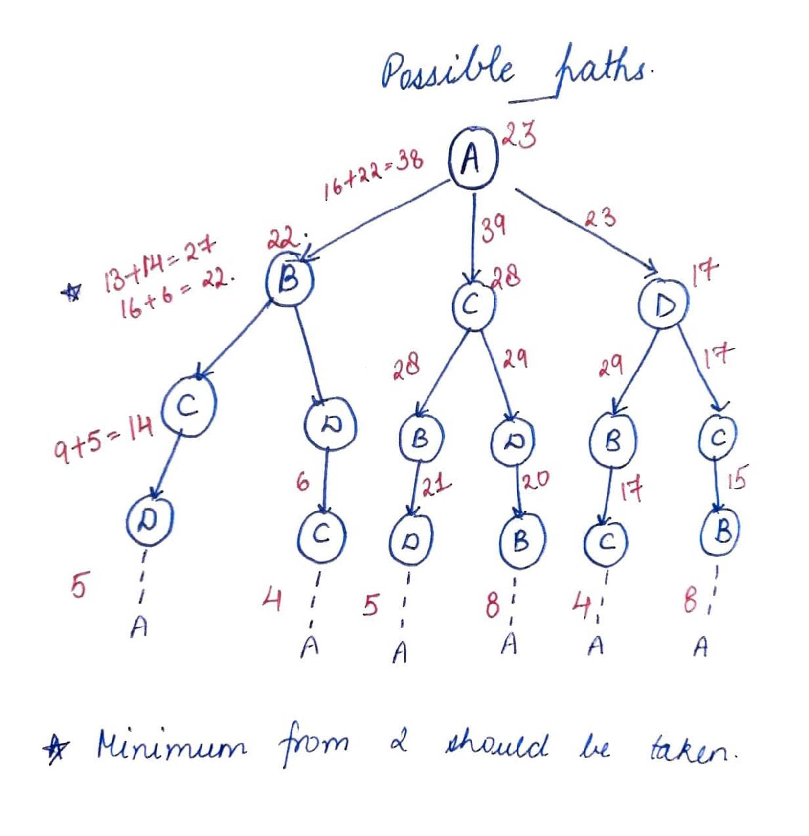
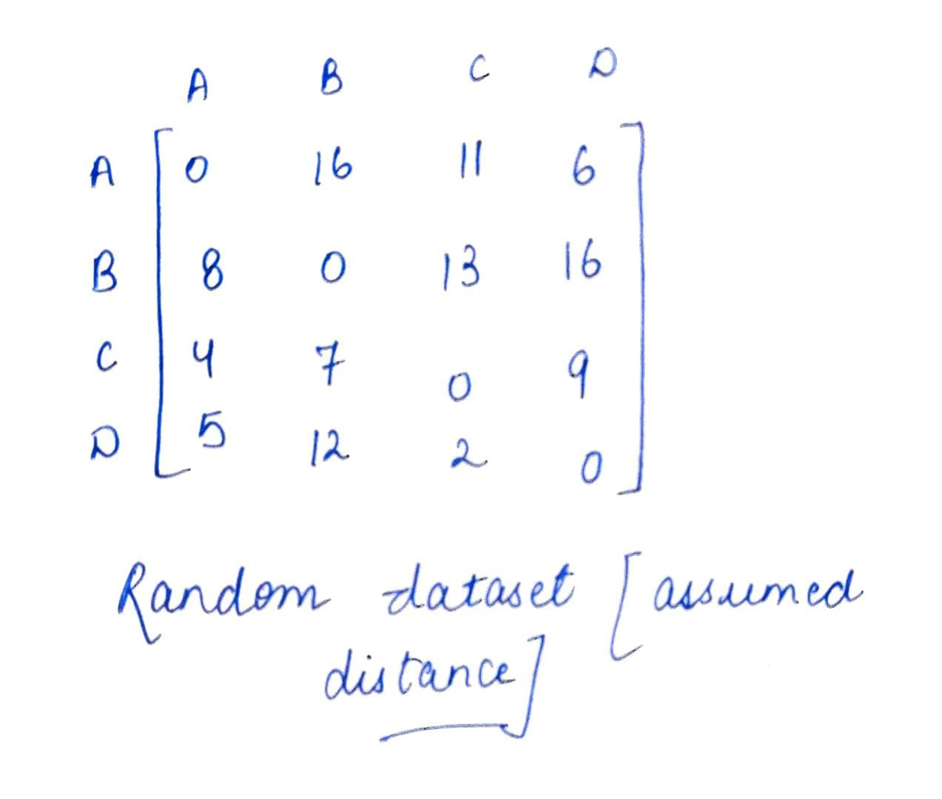
POSSIBLE PATH

Slide 7
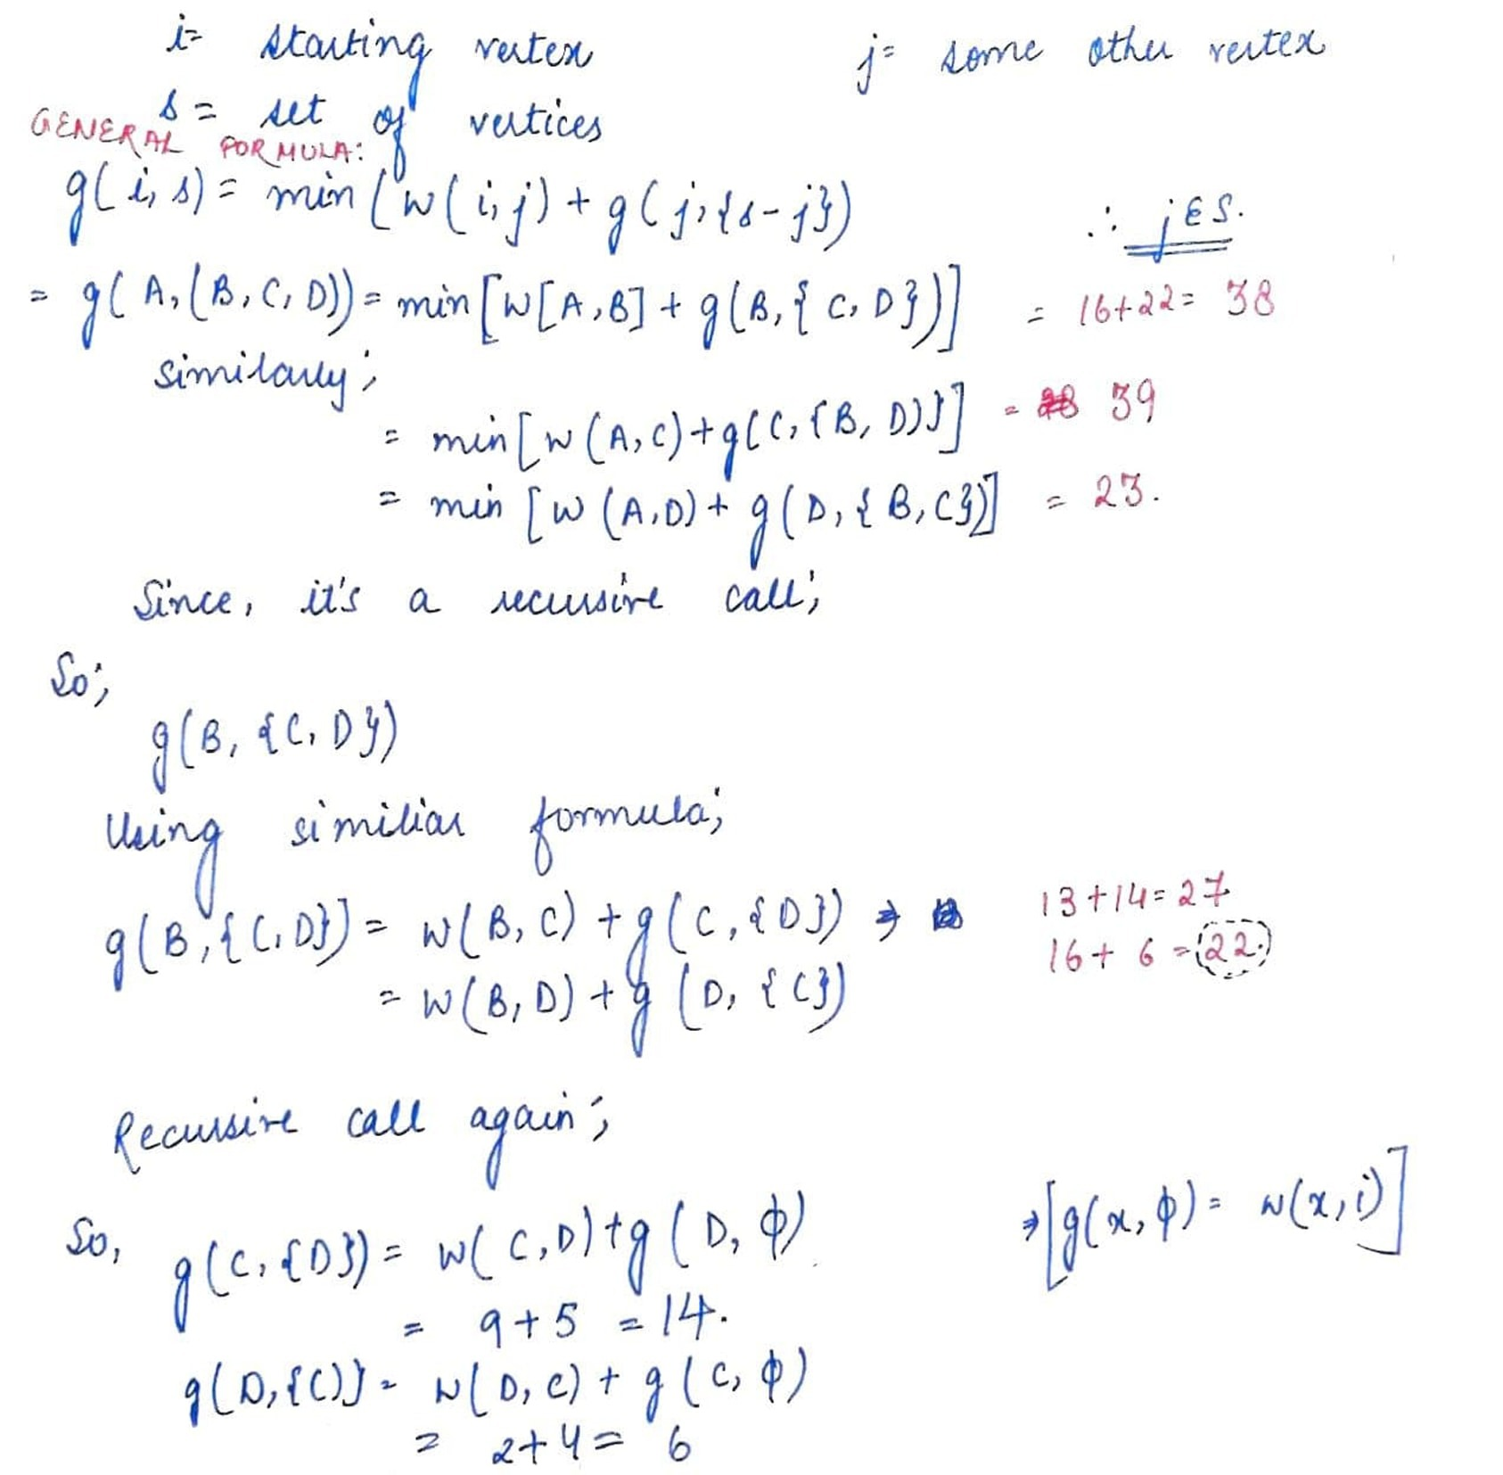
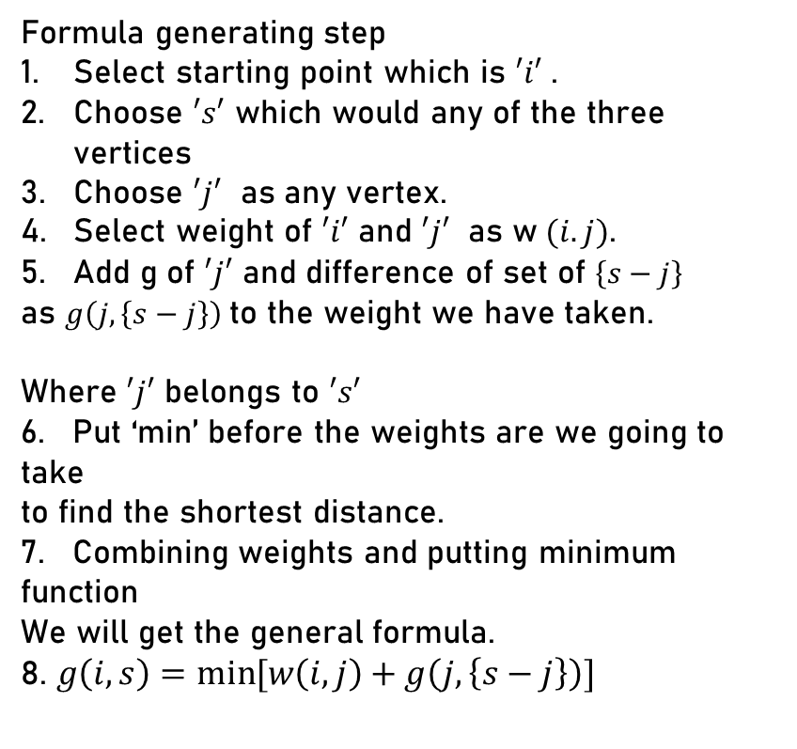
SOLUTION
Formula generating step
Select starting point which is $′i′$ .
Choose $′s′$ which would any of the three vertices
Choose $′j′$ as any vertex.
Select weight of $′i′$ and $′j′$ as w $(i.j)$.
Add g of $′j′$ and difference of set of $\left\{s−j\right\}$
as $g\left(j,\left\{s−j\right\}\right)$to the weight we have taken.
Where $′j′$ belongs to $′s′$
6. Put ‘min’ before the weights are we going to take
to find the shortest distance.
7. Combining weights and putting minimum function
We will get the general formula.
8. $g\left(i,s\right)=min⁡[w\left(i,j\right)+g\left(j,\left\{s−j\right\}\right)]$

Slide 8
CONCLUSION
Concludingly, after applying the dynamic programming approach
we can evidently see that the
Route :
A-> D -> C -> B ->A
having the least weight as "23", which was earlier shown by
root traversing method too.

Slide 9
THANK YOU

